Slide 1

A Review on Landslide Susceptibility Studies
Department of Civil Engineering
Indian Institute of Technology Guwahati
Assam, India - 781039
Course Instructor Dr. Rishikesh Bharti
Associate Professor, Dept of Civil Engineering
Presented by,
ALTMASH (244104002)
ROCK MECHANICS

Slide 2
Content:-
Introduction
Study Area
Methodology
Results and Discussion
Conclusion
References

Slide 3
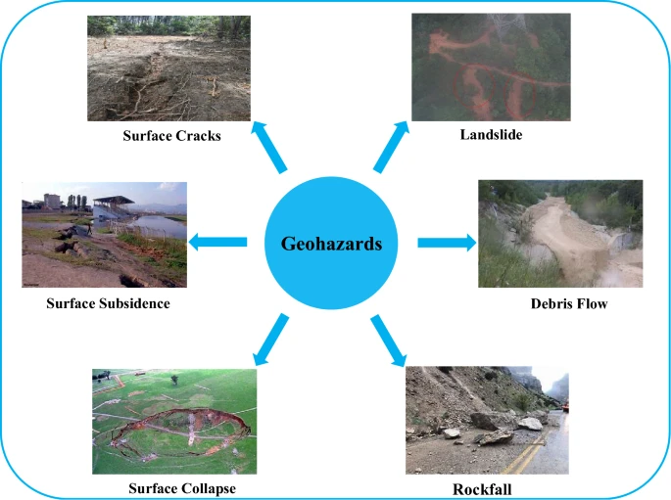
1. INTRODUCTION:-
⮚A Hazard can be defined as “a dangerous condition or event, that threat or have the potential for causing injury to life or damage to property or the environment.”
⮚Hazards can be grouped into two broad categories namely natural and manmade.
Fig 1.1 Types of Geohazards ( Qin et al., 2022)

Slide 4
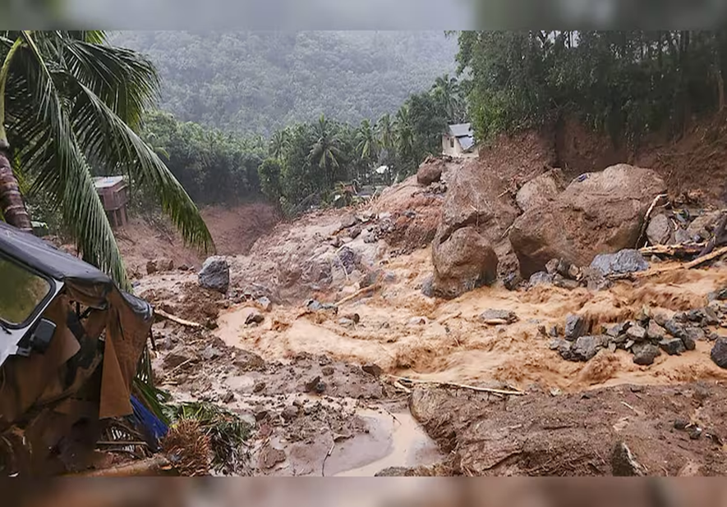
1.1 Landslide
Landslide refers to the sudden movement of materials down a slope.
The materials can be rock, soil or debris.
The most important driving factor behind landslide is when the shear stress being developed due to any external force/mechanism exceeds the shear strength of the material.
Fig 1.2 Wayanad Landslide in 2024 (Press Trust of India)

Slide 5
1.1 Landslide (contd.)
Landslides, considered among the most devastating natural hazards, are responsible for causing massive damage of lives and property, with some studies estimating landslides being responsible for around 17% of natural deaths around the world (CRED, 2022).
The factors contributing to landslides vary over a large domain.
WHAT CAUSES LANDSLIDES ???
There are two primary categories of causes of landslides:
Causes of landslide
Natural
Manmade

Slide 6
NATURAL CAUSES | HUMAN CAUSES
High rainfall | Excavation of slope
Tectonic Activity | Artificial Vibration
Vegetation Cover | Road cutting
Earthquake | Deforestation
Flood etc. | Mining etc.

Slide 7
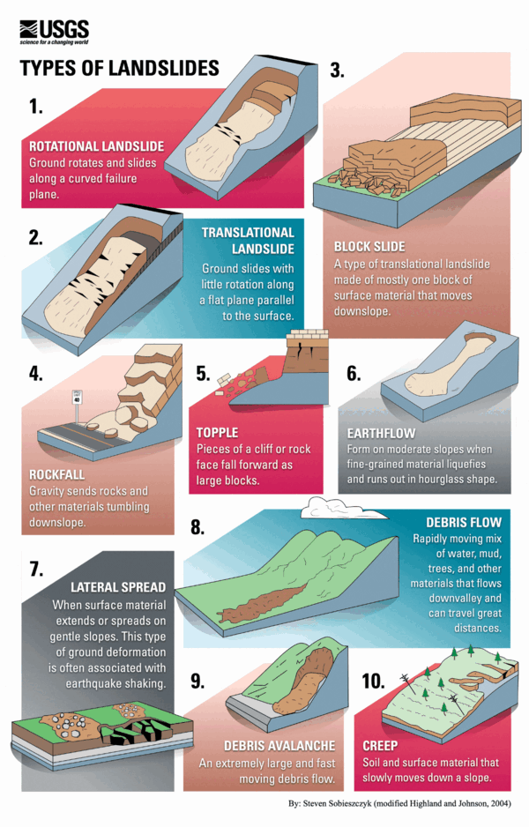
Fig 1.3 Types of Landslides (USGS)

Slide 8
2. STUDY AREA:-
The inventory factors that are mainly responsible for the triggering of a landslide event varies from area to area.
The triggering mechanisms for a landslide event to occur are hydrological factors, seismic activity, deforestation, anthropogenic factors etc.
There are several predisposing factors that induces the triggering mechanism for a landslide event to occur which varies for different area.
These predisposing factors are taken into account for landslide susceptibility identification in a particular area.
For our purpose of study, the different study areas that are considered for generating LSM (Landslide Susceptibility Mapping) are Xunwu (China), Cambodia, Pithoragarh, Uttarakhand and an overview of landslides across the political boundary of India.

Slide 9
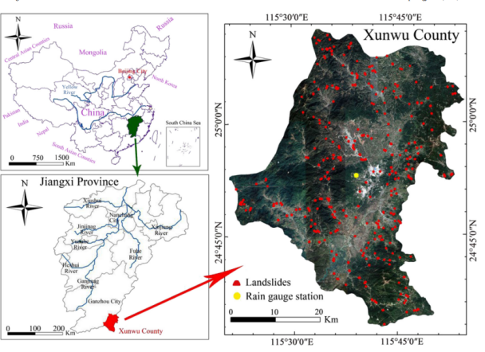
Why this study area?
Complex geology in East -West direction of Xunwu County.
Dense river network.
High annual mean rainfall.
Recorded data of historical landslides are much higher in last 40 years (like 325 landslides).
Fig 2.1 Study Area Map of Xunwu, China (Huang et al., 2004)

Slide 10
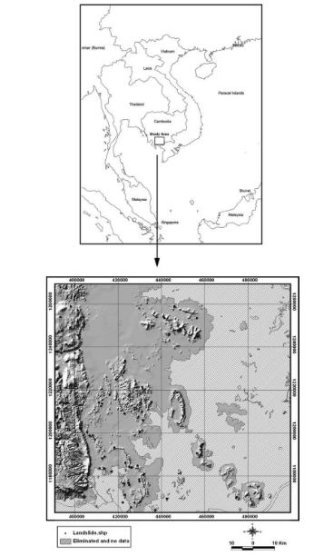
Located at High-altitude.
Gross lithology mainly Sandstone and weathered Dacite.
Originally forested, now covered with bushes due to deforestation.
Land cover map from Landsat TM (30 m resolution).
GIS database: slope, aspect, curvature, drainage, lithology, lineament, land cover.
Study area grid: 30 × 30 m cells.
Fig 2.2 Study area and landslide location with hillshade map of Damrei Romel area, Cambodia (Lee and Sambath, 2006)

Slide 11
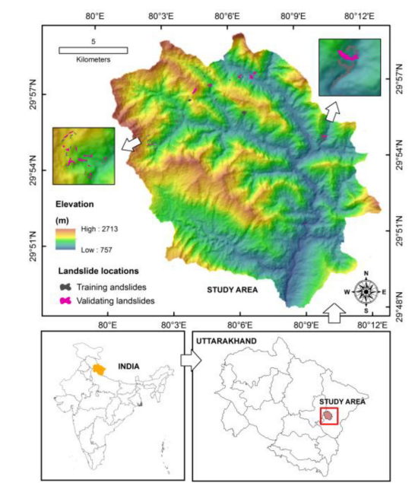
Structurally unstable, tectonically active Himalayan terrain.
Indo-Eurasian plate collision causes earthquakes and landslides.
2009 Kuity village landslide killed 43 people.
Hilly terrain (elevation: 757–2713 m) with deep river valleys.
Landslides occur on steep slopes, near roads, and river valleys.
Geology: Folded and faulted metamorphic rocks (phyllite, schist, gneiss, quartzite).
Tectonically disturbed and highly landslide-prone.
Fig 2.3 Location map of Pithoragarh, Uttarakhand (Pham et.al 2020)

Slide 12
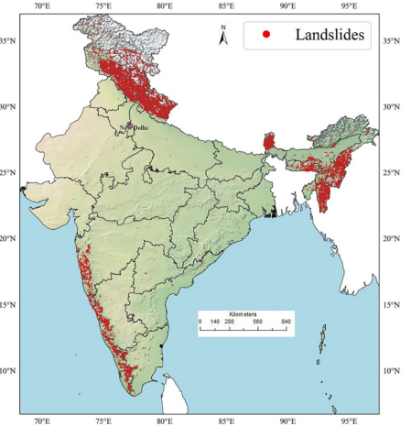
India accounts for ~8% of global landslide fatalities (~847 deaths/year).
Assam floods and landslides (2022) displaced 1.7 million people.
Most landslides occur in NW & NE Himalayas and Western Ghats.
Himalayas: Rock Falls due to steep slopes, sedimentary rocks, and river erosion.
Western Ghats: Mudslides due to basalt rocks, thick regolith, and heavy rainfall.
Anthropogenic factors (urbanization, road construction) increase landslide risk.
2013 Uttarakhand disaster led to the National Landslide Susceptibility Mapping (NLSM).
Fig 2.4 Landslide inventory of India (Sharma et.al 2023)

Slide 13
3. Methodology
3.1 Lee and Sambath, 2006
Aerial imagery and Field Surveys
Data Collection and Preparation
Data Digitised and converted from vector to raster format
GIS database (includes Topography, Geological and land cover data)
Key landslide influencing factors were derived from the Dataset such as -
1. Slope, 2. Aspect, 3. Curvature,4. Lithology, 5. Lineament Distance

Slide 14
Model Application
Frequency Ratio Model
Logistic Regression Model
if FR > 1 - represents strong correlation with landslide for the particular factor
if FR < 1 - represents strong correlation with landslide for the particular factor
Landslide Susceptibility Index (LSI)
Higher LSI values represents Greater landslide susceptibility.
Lower LSI values represents Lower landslide susceptibility.
It works in binary classification.
Predicts the probability of landslide occurrence based on multiple independent variables (slope, land cover, geology, etc.).
LRM analyzes all factors together to find the best-fitting equation that predicts landslides.

Slide 15
Landslide susceptibility mapping
Model Validation & Testing
Landslide Susceptibility maps were generated using both the models.
To ensure accuracy, the generated map was compared with known landslide locations

Slide 16
3.2 Huang et al., 2004
Gathering of key datasets -
landslide inventory
historical rainfall data
Landslide Susceptibility mapping with critical rainfall threshold calculations
Logistic Regression (LR)
Landslide Susceptibility Prediction Modeling
Support Vector Machine (SVM)
Landslide hazard warning maps are generated in ArcGIS.
Random Forest (RF)
Critical Rainfall Threshold Calculation
EI-D (Effective Rainfall Intensity-Duration)
EE-D (Cumulative Effective Rainfall-Duration)
EE-EI (Cumulative Effective Rainfall-Effective Rainfall Intensity)

Slide 17
3.3 Pham et.al 2020
Data Collection and identification of key factors
Model Construction
Collecting landslide inventory
Identify key influencing factors
Ensemble - Rotation Forest
RF with Decision Tree (RFDT)
RF with Support Vector Machine (RFSVM)
RF with Artificial Neural Network (RFANN)
RF with Naive Bayes (RFNB)
50% for training the model
50% for validation to test its accuracy

Slide 18
Model Validation
Accuracy
Kappa Index
Root Mean Square Error
Area Under the Curve

Slide 19
3.4 Sharma et.al 2023
Data Collection
Data Preprocessing
Data Splitting and Normalisation
Handling Imbalance in training Data
Machine Learning Model Development
Landslide inventory data from GSI and COOLR.
Geospatial dataset ( DEM, Soil properties, etc)
Resample all dataset to uniform resolution
Handling of Missing Data
Split dataset into training, validation and testing sets
One sided selection technique
SVMSMOTE technique
Random Forest
Artificial Neural NEtworks
Support Vector Machine

Slide 20
3.4 Sharma et.al 2023
Ensemble learning
Model Validation and Performance Evaluation
Landslide Susceptibility Map Generation
LR has been used as the meta classifier.
Blending ensemble combines RF, ANN and SVM with LR method
MCC
AUC-ROC scores.
Generated utilising the trained ensembled models.

Slide 21
4. RESULTS AND DISCUSSION
4.1 Huang et.al, (2022)
From the historical data there were 325 landslide events covering an area about 8500 m² in the Xunwu China.
Main causes for the occurrence of landslide event are heavy precipitation, human activity and slope cutting
For landslide susceptibility prediction in Xunwu, the following predisposing factors are analyzed:
a)Slope: Areas with slopes greater than 13° are more susceptible.
b) Aspect: East and West-facing slopes are more prone due to complex geological structures.
c) Curvature: Concave areas are more susceptible than convex areas.
d) Distance from River: Areas within 300m of river channels show higher susceptibility.
e) Lithology: Carbonate and non-clastic rocks are more prone to landslides compared to metamorphic rocks.
f) Elevation: Elevations between 179-524m are more prone to landslides.

Slide 22
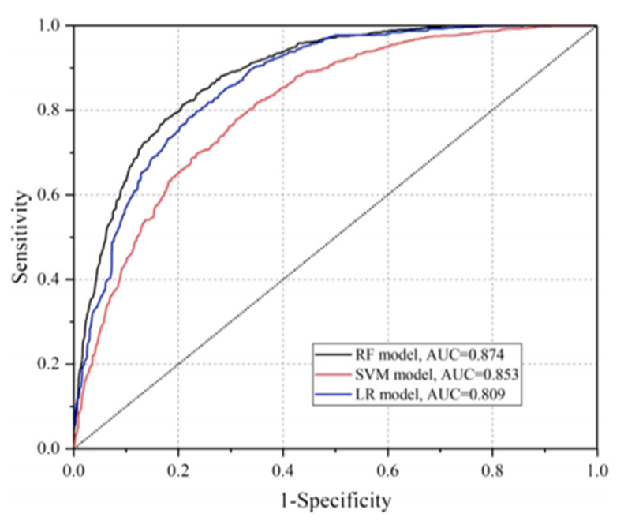
Application of Different Models for LSP
Three main statistical approach are taken into consideration for the determination of spatial probability of landslide that is Frequency Ratio (FR), Support Vector Machine (SVM), Logistic Regression (LR)
LSP accuracy | LR | 0.809
 | SVM | 0.853
 | RF | 0.874
LSP uncertainty | LR | 0.360
 | SVM | 0.301
 | RF | 0.291
Table 4.1 LSP Model Accuracy and Uncertainty Assessment
Fig 4.1 ROC curves for the RF model and SVM model(Huang et.al,2022)

Slide 23
ASSESSMENT OF CRITICAL RAINFALL THRESHOLD RELATED TO LANDSLIDE
The temporal probability of rainfall-induced landslides is calculated using a probabilistic analysis method. The main types of critical rainfall thresholds obtained are:
a.Rainfall Intensity and Duration (I-D)
b.Empirical Cumulative Rainfall Duration (E-D)
c.Empirical Cumulative Rainfall Intensity (E-I)
d.Threshold of Cumulative Rainfall
Among these methods I-D method is most effective because it includes the early rainfall events which may have the impact on the landslide even if the occurrence of the rainfall on the day of landslide is small.
The Effect of Daily Rainfall: 21% of landslides occurred on days with rainstorms (≥50 mm/day).
24% occurred during heavy rain (25–50 mm/day).
55% occurred on days with less than 25 mm/day, showing a lag effect.
Lag Effect of Rainfall: Landslides are not solely triggered by rainfall on the occurrence day.

Slide 24
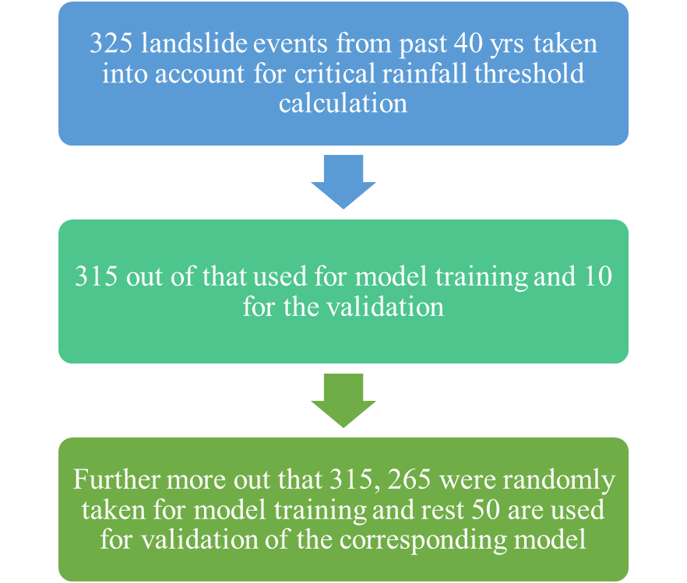
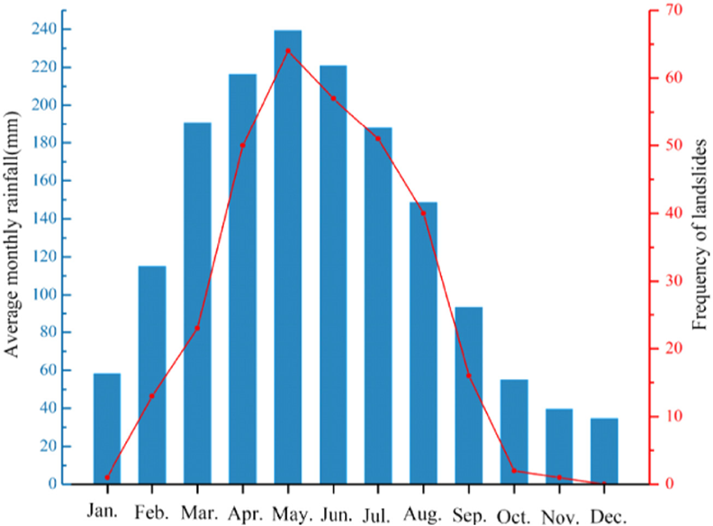
Fig 4.2 Monthly average rainfall and frequency of landslide events in nearly 40 years (Huang et.al. 2022)

Slide 25
4.2 Lee and Sambath,2006
Results and Interpretation:-
Landslide Susceptibility Analysis
Slope: Higher susceptibility in areas with slopes >11°.
Aspect: West and northeast-facing slopes most affected.
Curvature: Concave areas retain more water, increasing risk.
Distance from Drainage: Susceptibility increases beyond 500m.
Lithology: Rock types like shale, sandstone, and limestone have higher landslide occurrence.
Distance from Lineament: Areas within 2,500m of geological faults show higher probability.
Land Cover: Forest and shrubland areas show higher landslide occurrences.
Modeling & Accuracy:
Frequency Ratio Model - 86.97% accuracy
Logistic Regression Model - 86.37% accuracy

Slide 26
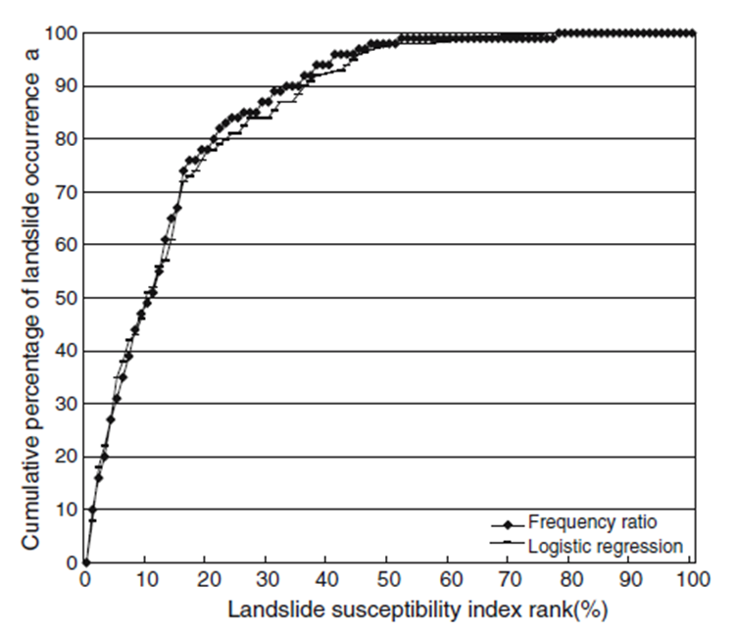
The Landslide Susceptibility Index (LSI) is then calculated using the following equation:
LSI = SLOPEr + ASPECTr + CURVATUREr + DRAINAGEr + GEOLOGYr +LINEAMENTr + LANDCOVERr
Fig 4.3 Illustration of cumulative frequency diagram showing landslide susceptibility index rank (x-axis) occurring in cumulative percent of landslide occurrence (y-axis) (Lee and Sambath, 2006)

Slide 27
4.3 Pham et.al, 2020
The performance of the four hybrid models was assessed using statistical indices for both training and validation datasets. The results are summarized in the following tables:
PARAMETER | RFDT | RFNB | RFANN | RFSVM
Accuracy | 96.31 | 78.57 | 94.40 | 88.45
Kappa Index | 0.926 | 0.572 | 0.8214 | 0.7691
RMSE | 0.185 | 0.382 | 0.2772 | 0.3036
PARAMETER | RFDT | RFNB | RFANN | RFSVM
Accuracy | 72.02 | 66.96 | 71.13 | 69.53
Kappa Index | 0.439 | 0.339 | 0.3617 | 0.3855
RMSE | 0.432 | 0.488 | 0.4849 | 0.4504
Table 4.2 Model performance using training dataset
Table 4.3 Model performance using validating dataset

Slide 28
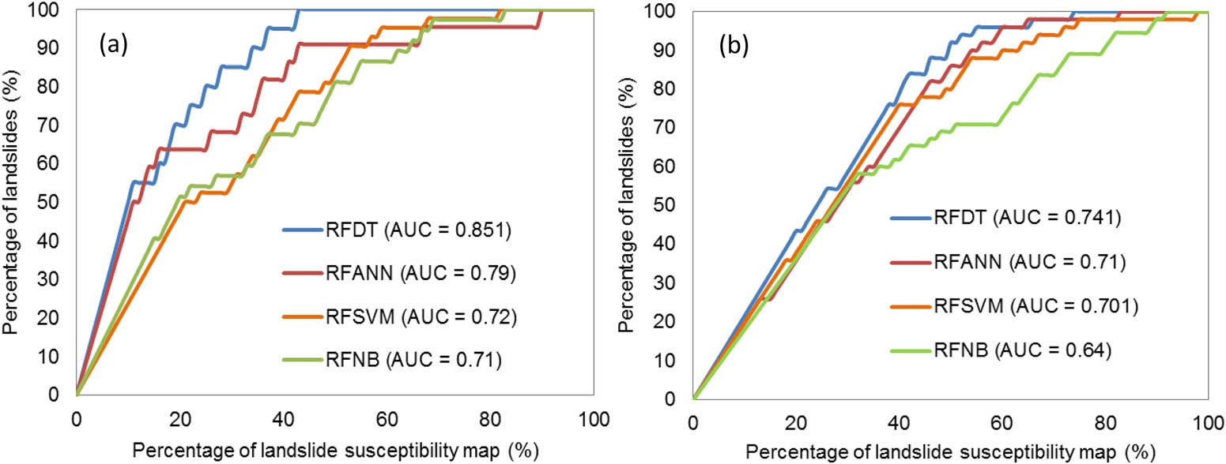
Model Validation using ROC Curves
The predictive capability of the models was further assessed using Success Rate Curves
(SRC) and Predictive Rate Curves (PRC). The Area Under the Curve (AUC) values for
both SRC and PRC indicated that the RFDT model had the highest predictive capability.
· RFDT: AUC = 0.741
· RFANN: AUC = 0.710
·RFSVM: AUC = 0.701
·RFNB: AUC = 0.640
Fig 4.4 Validation of landslide susceptibility maps:
(a) success rate curve and (b) predictive rate curve.

Slide 29
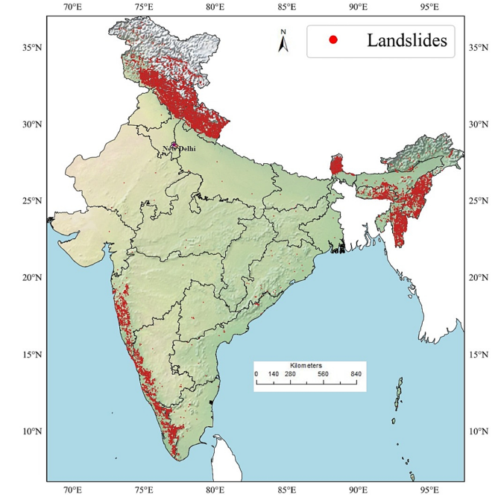
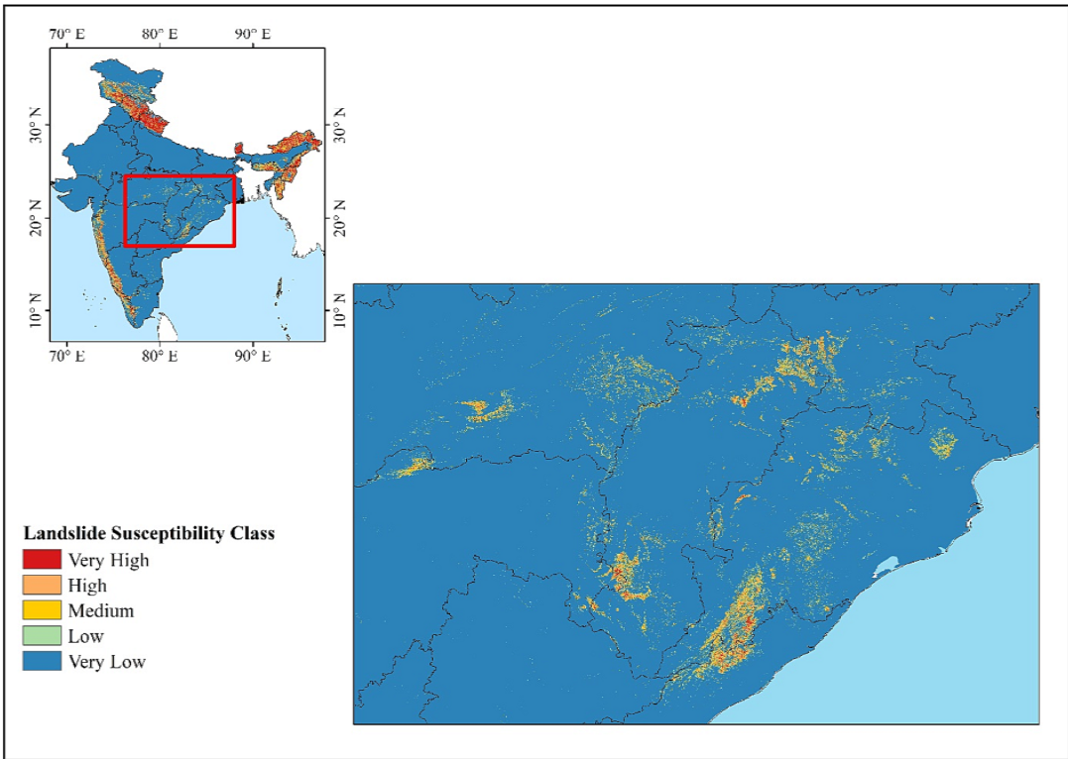
4.4 Sharma et al., 2023
4.75% area in India is highly susceptible to landslides.
New landslide susceptible zones in the Eastern Ghats, which were previously unreported in government records.
Fig 4.5 Existing government Landslide Inventory (Sharma et al. 2023)
Fig 4.6 Newly identified landslide susceptible zones in Eastern ghats (Sharma et al. 2023)

Slide 30
4.4 Sharma et al., 2023
Ensemble model has outperformed all the individual Machine Learning models
AUCROC Curve, Matthews Correlation Coefficient (MCC) and Normalized Confusion Matrix were used for the comparative study.
Accuracy = 95.73%, Sensitivity = 97.08% and MCC = 0.915
India’s first national scale machine learning based Landslide Susceptibility Map (Indian Landslide Susceptibility Map) with a high resolution of 0.001°

Slide 31
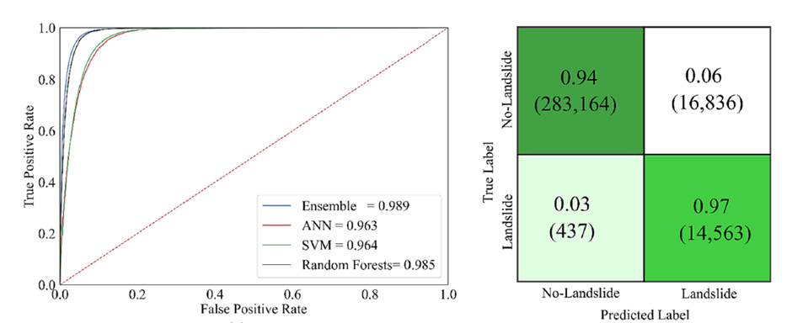
4.4 Sharma et al., 2023
Fig 4.7 (a) AUCROC curves for individual machine learning models and blended ensemble model (b) Normalized Confusion Matrix for the ensemble model (Sharma et al., 2023)

Slide 32
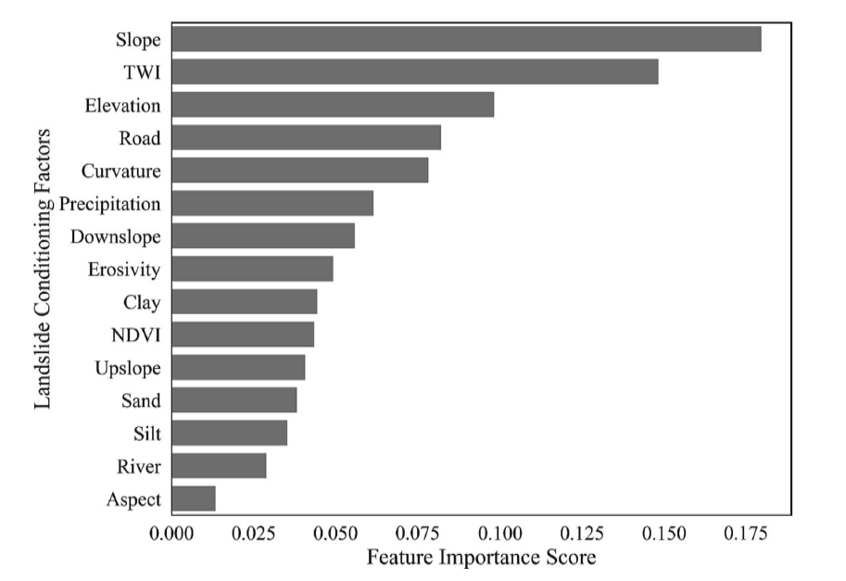
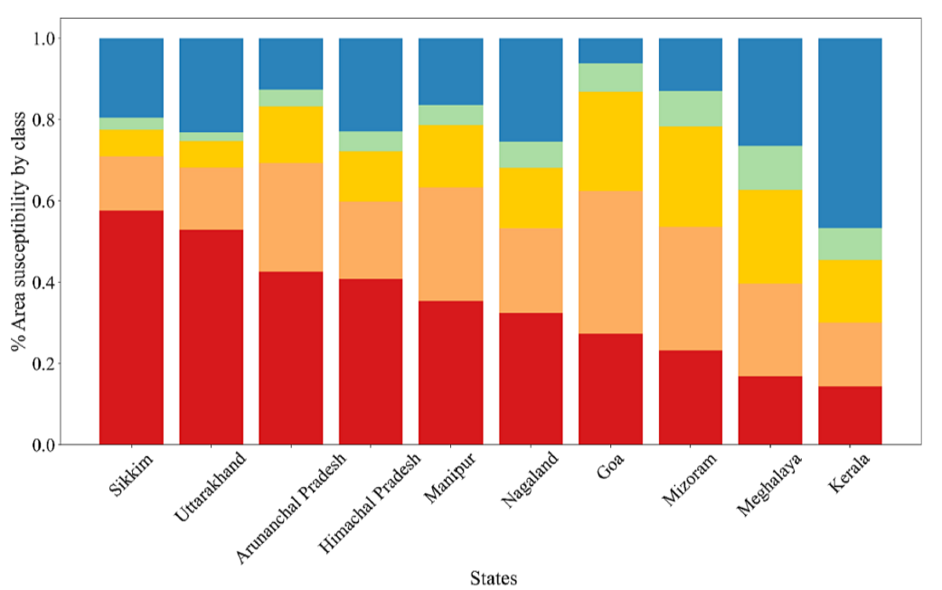
4.4 Sharma et al., 2023
Fig 4.8 Feature Importance using Random Forest model
Fig 4.9 Top 10 landslide susceptible states in India (by the percentage of area).

Slide 33
5. Conclusion
Landslides cause huge damage of lives and property across the world and therefore extensive research have been carried out over the years to understand the underlying mechanism
Methods like Random Forest, Support Vector Machine and Artificial Neural Network along with using ensemble approach have been used to develop Landslide Susceptibility Maps for different regions of the world.
Although most of these methods are technologically advanced, yet there are few shortcomings like presence of sensor and calibration noise in the satellite data associated with them.
Therefore, further studies involving a better data set can be adopted to develop more reliable landslide susceptibility maps.

Slide 34
6. References
Huang, F., Chen, J., Liu, W., Huang, J., Hong, H., Chen, W., Regional rainfall-induced landslide hazard warning based on landslide susceptibility mapping and a critical rainfall threshold, Geomorphology, Volume 408,2022,108236, ISSN 0169-555X, https://doi.org/10.1016/j.geomorph.2022.108236.
Lee, S., Sambath, T. Landslide susceptibility mapping in the Damrei Romel area, Cambodia using frequency ratio and logistic regression models. Environ Geol 50, 847–855 (2006). https://doi.org/10.1007/s00254-006-0256-7
Pham, B.T, Prakash, I., Dou, J., Singh, S.K, Trinh, P.T, Tran, H.T, Le, T.M, Phong, T.V., Khoi, D.K, Shirzadi, A. & Bui, D.T (2020) A novel hybrid approach of landslide susceptibility modelling using rotation forest ensemble and different base classifiers, Geocarto International, 35:12, 1267-1292, DOI:10.1080/10106049.2018.1559885
Sharma, N., Saharia,M., Ramana,G.V. 2023 High resolution landslide susceptibility mapping using ensemble machine learning and geospatial big data, CATENA,Volume 235, 2023,107653,ISSN 0341-8162, https://doi.org/10.1016/j.catena.2023.107653.

Slide 35


